Slide 1
Case Study 3 University Registration System
Kaitlyn Davis, Nhan Do, Emilio Lopez, Andrew Meyer

Slide 2
Initial Document

Slide 3
The Problem
A software is to be developed for automating the functioning of a University registration system (URS).
Members include: students, faculty, and administrator.
A course will be part of one of the departments at the university.
The URS performs the following functions:
Registration of Students
Maintenance of Information

Slide 4
Functions
Registration of Students
Students shall be able to search for courses by name and department.
Students may enroll in courses per the allowed range of credits and if the student meets the requirements for the course.
Courses may be dropped by a student during the specified period. Students, once the drop period has past, may withdraw from a course.
If the number of students enrolled in a course equals the course capacity, students may join a waitlist for that course.
Maintenance of Information
Details of all members with their name, demographics, unique identification number, and more.
Details of all courses with its title, course number, faculty member, department, program, capacity, number of credits, total students enrolled, and more.
Details of student enrollment in courses

Slide 5
Some Initial System Requirements
3 Members: Student, Faculty, Administrator
Faculty may add/modify/view/delete a course
Students may register/drop/withdraw/view a course
Administrator maintains details of course and generates reports
Max credit hours for a student: 19
Faculty and Students may search for a course

Slide 6
Software Requirement Specification

Slide 7
Purpose
The University Registration System (URS) maintains information about various courses available at the University.
The URS also maintains all student and faculty records as they pertain to the courses at the University.
These records are maintained in order to provide detailed information on courses.

Slide 8
Do’s of System
Provide search facility to check the details of a course at the university.
Maintain details of courses available at the university
Generate the following reports:
Course Registration of a Student
Details of a Course
All students’ Course Information
List All Courses
Search for a courses using a variety of search terms such as:
Course Number
Course Title
Department
Schedule
Instructor
Location
Course Capacity
Register for a course
Drop a course
Withdraw from a course

Slide 9
Don’t-s of System
Login ID and password information is issued by another university system.
Financial aid data is handled by the bursar’s office
Course auditing is not covered

Slide 10
Benefits
Easy searching of courses
Printing of reports
Efficient enrollment and withdraw/drop of courses
Accurate course enrollment details

Slide 11
Product Perspective
The URS shall be developed using client/server architecture and will be compatible with Microsoft Windows Operating System.
The front end of the system will be developed using Microsoft Access and C# while the backend will also be created in Microsoft Access using MySQL server.
Front End Client Application
(Create/Modify, Search, Withdraw/Drop, Reporting facility)
Backend Database

Slide 12
Product Functions
Login facility for only authorized access
Administrator/Faculty will be able to maintain course details
Student will be able to register, drop/withdraw a course
Administrator/Faculty/
Student will be able to
search for a course
Administrator can generate reports

Slide 13
Another View of Functions
Login
Maintain Course Details
Register for a Course
Search for a Course
Drop/Withdraw from a Course
Display Course Information
Generate Report

Slide 14
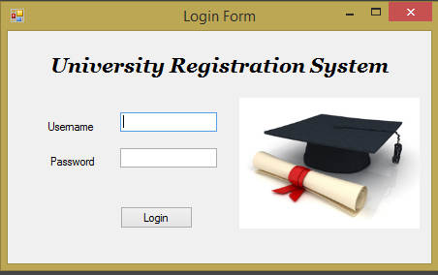
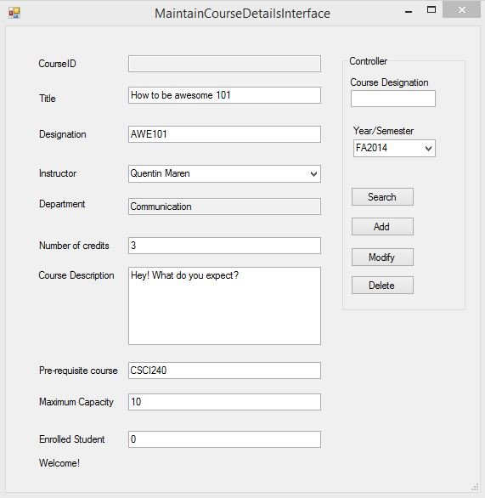
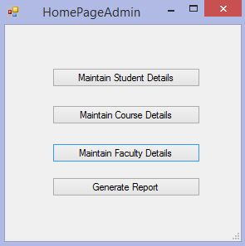
Interface Examples

Slide 15
Assumptions
Billing and payroll related to this system or this system’s users will be handled by the Bursar’s office
The admission’s office will handle course equivalency for transfer students.
A department of a course will handle course audits.
Other university system maintain and handle member information of Student, Faculty, and Administrator members.

Slide 16
Use Case Diagram

Slide 17
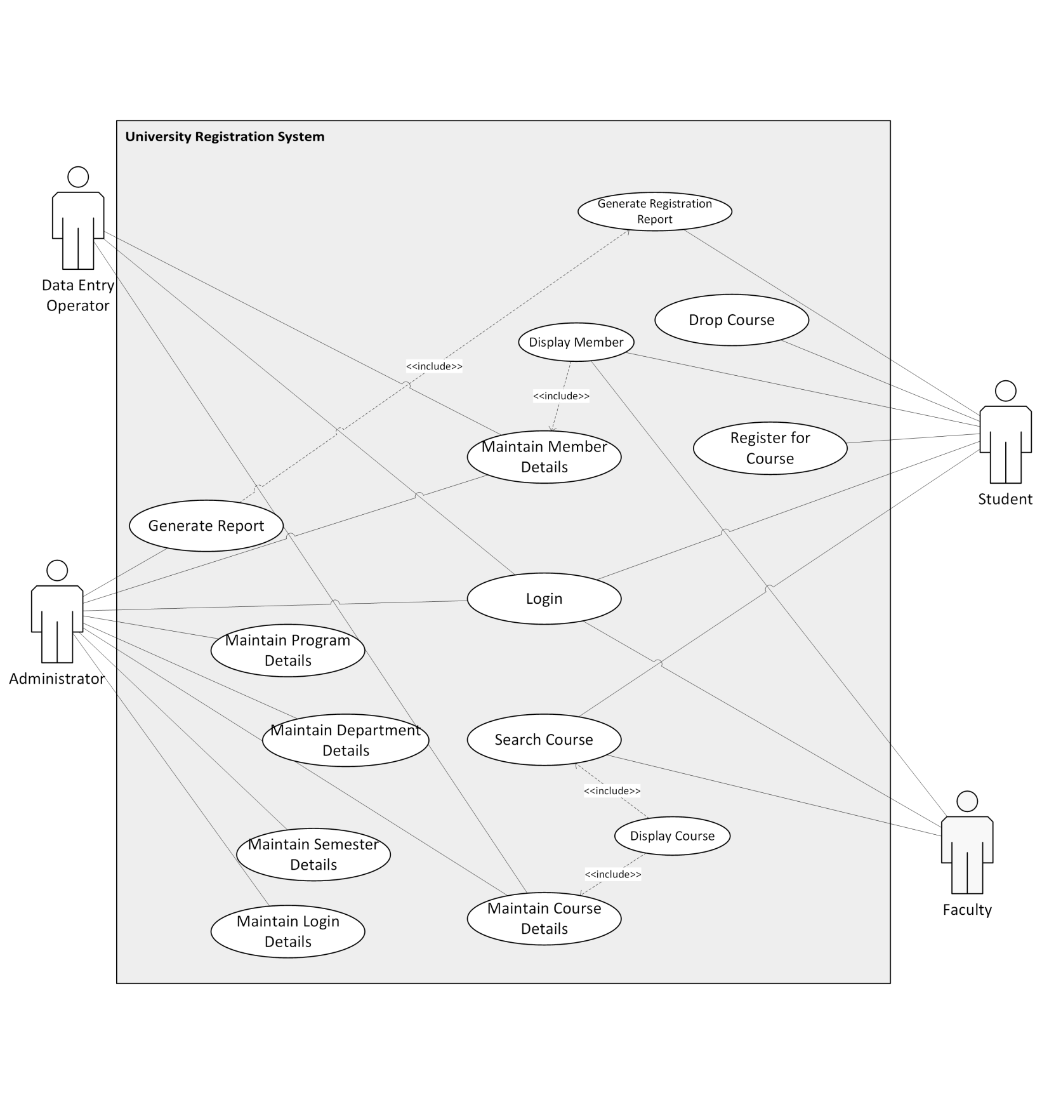

Slide 18
Uml dIAGRAM
Click Here

Slide 19
Use Case Description - Maintain course Details & Display course

Slide 20
Maintain Course Details

Slide 21
Maintain Course Details – Basic Flow

Slide 22
Maintain Course Details – Alt Flow

Slide 23
Maintain Course Details

Slide 24
Display Course

Slide 25
Display Course Continued

Slide 26
Class diagrams – Maintain Course Details & Display Course

Slide 27
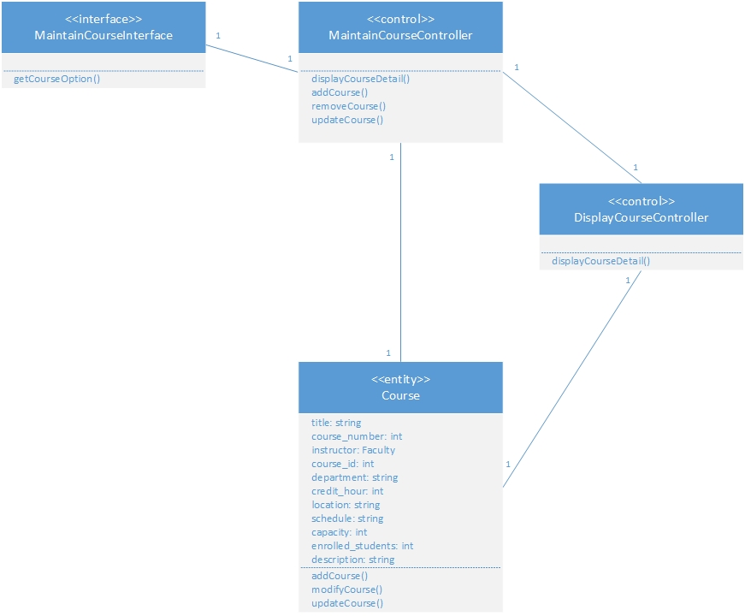
Maintain Course Details

Slide 28
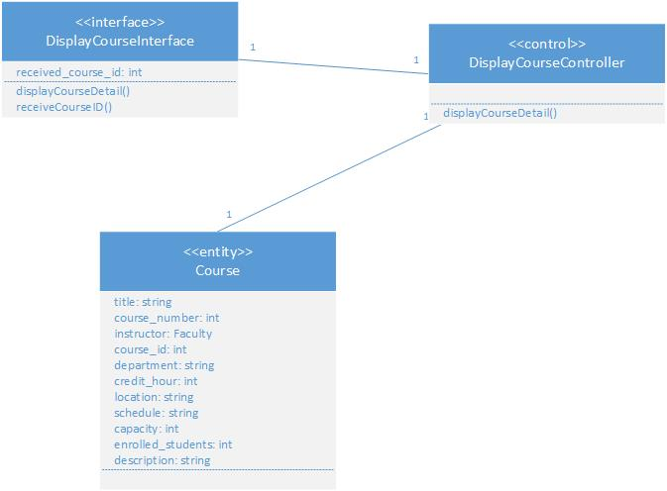
Display Course

Slide 29
Sequence & Activity diagrams – login & Generate Report

Slide 30
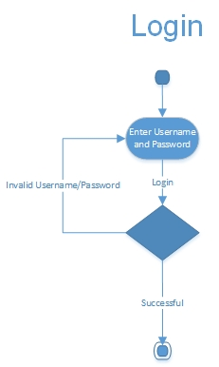
LOGIN – Activity Diagram

Slide 31
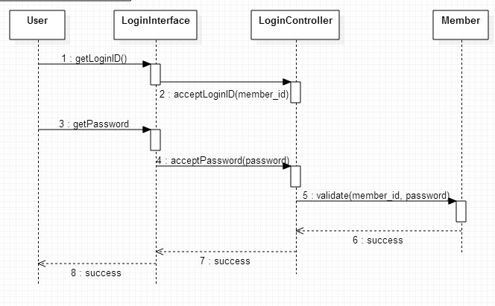
Login – Basic Flow

Slide 32
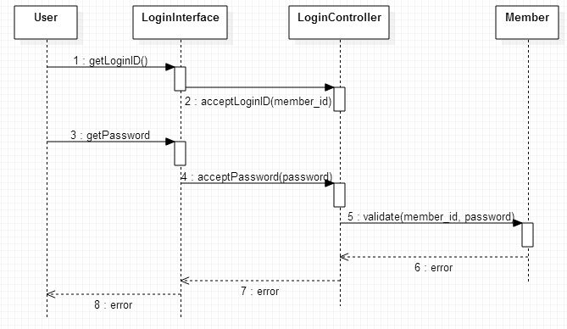
Login – Alternative Flow
Unauthorized Login

Slide 33
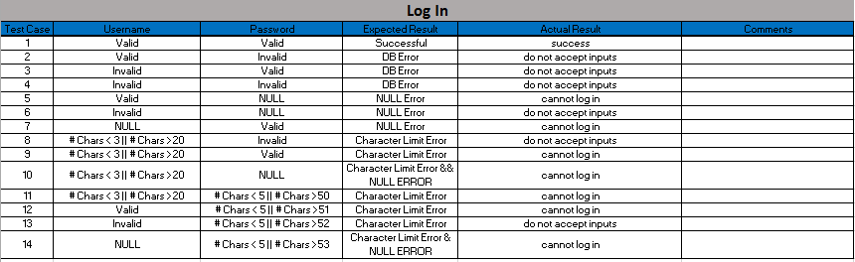
Login test cases

Slide 34
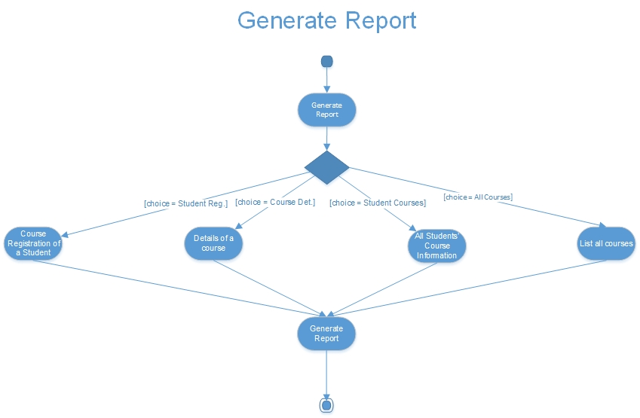
Generate report – activity diagram

Slide 35
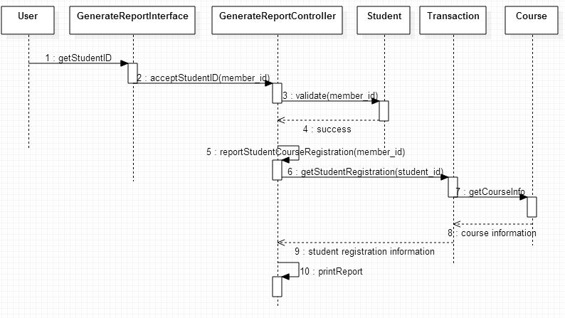
Generate Report – Basic Flow 1
Get Course Registration of a Student

Slide 36
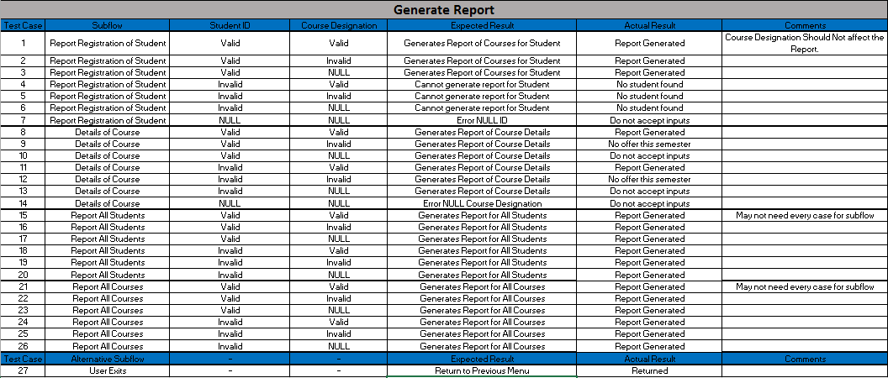
Generate report test cases

Slide 37

demo

Slide 38
The End

